Slide 1
AI-Driven Wind Turbine Fault Detection and Performance Optimization Using SCADA Data

Slide 2
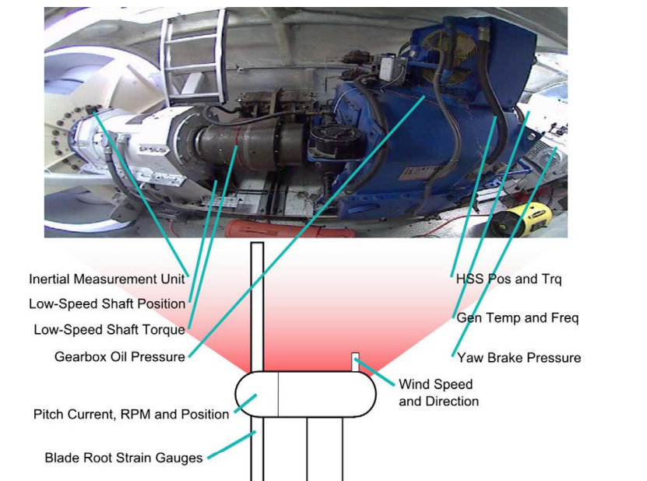
Abstract
This project utilizes machine learning models to analyze wind turbine performance, detect failure conditions, and predict power output.
Key parameters such as wind speed, direction, and power generation are examined to identify inefficiencies on SCADA data.
Various classification models (Random Forest, SVM, Decision Tree, Neural Network) are trained to detect turbine failures, with Random Forest achieving 97.86% accuracy.
XGBoost and CatBoost emerged as the most accurate for power prediction, achieving R² scores above 89%.
The study also applies SMOTE to handle class imbalance, ensuring better failure detection.
The results demonstrate the effectiveness of AI-driven predictive maintenance, improving energy efficiency and turbine reliability. 🚀

Slide 3
Introduction
Wind energy is a crucial renewable resource, but its efficiency depends on factors such as wind speed, direction, and turbine performance.
Unexpected failures and inconsistent power output can lead to energy losses and increased maintenance costs.
This study leverages machine learning techniques to analyze wind turbine operations, detect failures, and predict power generation.
By applying advanced classification and regression models, the project aims to enhance predictive maintenance and optimize energy efficiency.

Slide 4
Motivation
Problem Statement
Wind turbines face operational inefficiencies due to unpredictable failures and varying wind conditions.
Existing systems lack accurate methods to predict turbine failures and optimize power generation.
The non-linearity of wind characteristics makes traditional forecasting techniques ineffective.
This study aims to develop machine learning models for failure classification and power prediction, providing a reliable and automated approach to enhance turbine performance, minimize downtime, and improve energy output.
Wind turbines often experience unplanned failures and fluctuations in energy output, impacting operational reliability. Traditional rule-based maintenance approaches are inefficient, leading to higher costs and downtime.
Machine learning offers a data-driven solution by detecting patterns in turbine performance, identifying failure risks, and predicting power generation more accurately.
This project seeks to improve turbine efficiency, reduce maintenance costs, and maximize wind energy utilization through AI-driven insights.

Slide 5
Literature Survey
Methodology | Key Considerations
SCADA-Based Condition Monitoring | - SCADA data includes power output, wind speed, generator speed, temperature, voltage, and current. - Challenges: Low sampling rate, high noise, and large data volume.
Power Curve Analysis | - Models turbine performance under normal conditions. - Polynomial regression, neural networks, and Gaussian processes are used. - Detects deviations indicating controller faults, blade pitch errors, or generator malfunctions. - Requires threshold-based alert systems.
Anomaly Detection | - Identifies abnormal patterns in SCADA data. - Useful for detecting unknown faults. - Requires robust statistical or AI-based techniques.
Supervised Learning (Classification & Regression) | - Requires labeled data for fault classification. - Algorithms: Decision Trees, Random Forest, Neural Networks, Support Vector Machines. - Used for failure type detection and remaining useful life prediction. - Limited by the availability of high-quality labeled data.
Unsupervised Learning (Clustering & Dimensionality Reduction) | - No labeled data required. - Algorithms: K-Means, Hierarchical Clustering, PCA, Autoencoders. - Helps in detecting new or unknown fault patterns.
Semi-Supervised Learning (Hybrid Approaches) | - Combines labeled and unlabeled data. - Methods: Self-training, Co-training, Transfer Learning. - Useful when labeled data is scarce or imbalanced. - Can improve model generalization across different turbines.
Fault Prediction | - Uses historical SCADA data to predict failures before they occur. - Neural Networks and Time-Series Analysis (LSTMs) are effective. - Trade-off between prediction accuracy and lead time.
Challenges & Future Directions | - Need for high-quality labeled SCADA data. - Balancing model accuracy with computational efficiency. - Developing interpretable AI models for industry adoption. - Integrating real-time analytics for predictive maintenance.
The summary of the Wind Turbine Condition Monitoring Survey briefly overviews the methodologies and key aspects considered in wind turbine condition monitoring using SCADA data.

Slide 6
Dataset
Dataset Overview & Description
The dataset contains 26,997 observations of wind turbine performance, capturing key parameters that influence energy generation. It includes:
Date/Time: Timestamp of each recorded observation.
Wind Speed (m/s): Measures the speed of wind impacting the turbine.
Wind Direction (°): Represents the angle at which wind approaches the turbine.
LV Active Power (kW): The actual power output generated.
Theoretical Power Curve (KWh): Expected power output under ideal conditions.
Additionally, time-based features such as Week, Month, Season, Day, and Hour were extracted for deeper analysis.
Some missing values were identified and handled through imputation.
The dataset is crucial for training machine learning models to classify failures and predict power output, optimizing turbine efficiency and reliability.

Slide 7
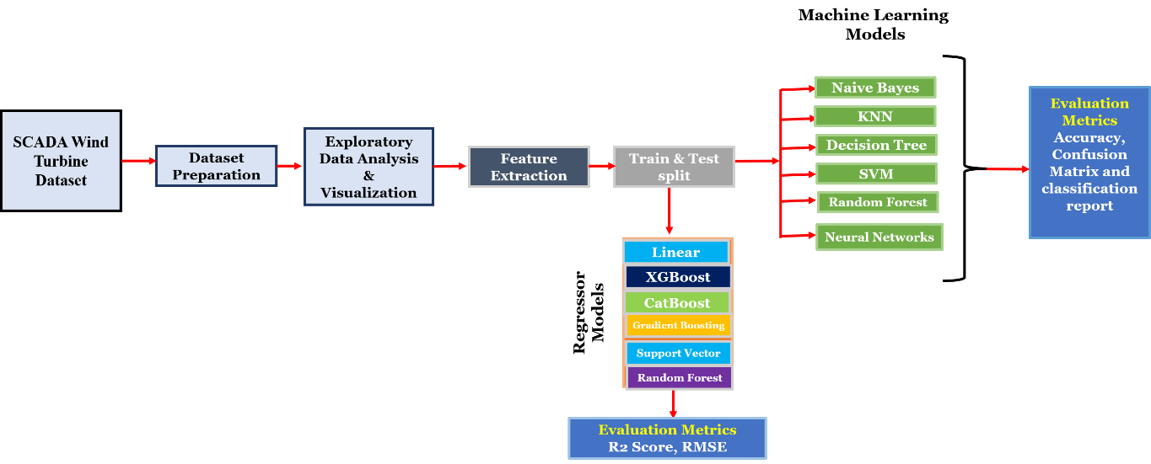
Methodology

Slide 8
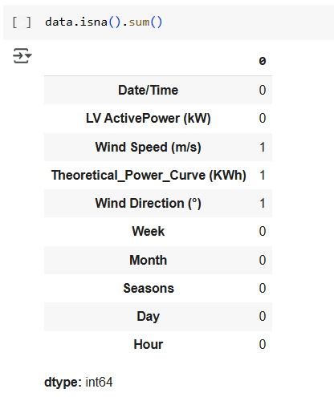
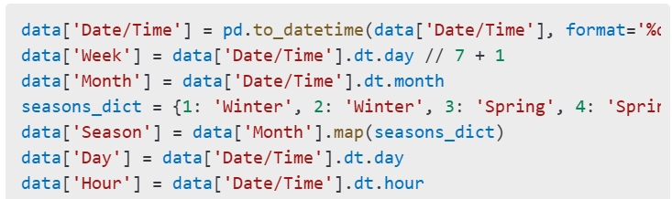
Data Processing
To ensure high-quality data for machine learning models, several preprocessing steps were applied:
Handling Missing Values: Identified in Wind Speed, Wind Direction, and Theoretical Power Curve, and resolved through imputation or removal.
Date/Time Conversion: Transformed into a standard format to extract Week, Month, Season, Day, and Hour for time-based analysis.

Slide 9
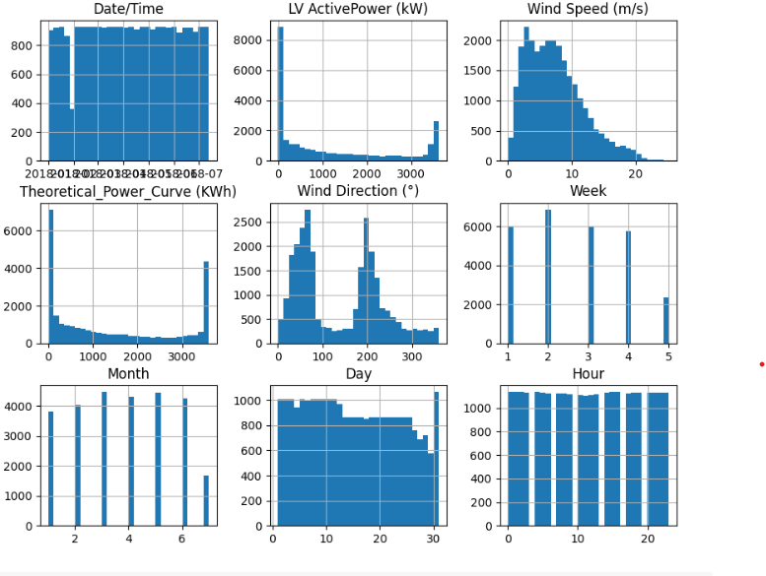
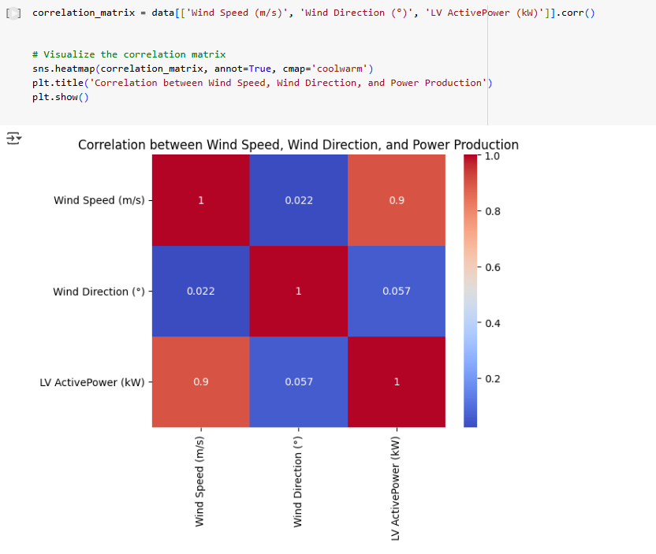
Exploratory Data Analysis (EDA)
Correlation Matrix
Histograms

Slide 10
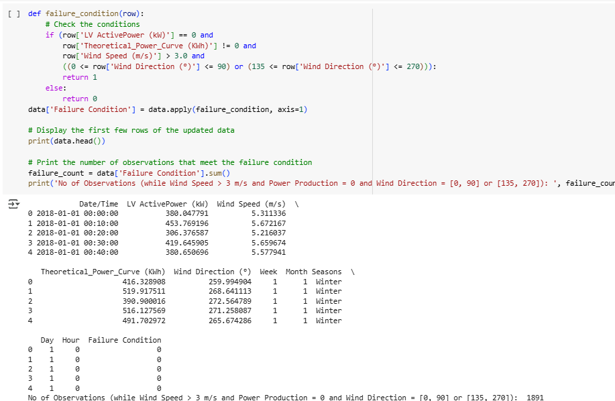
Feature Extraction
Failure Condition Labeling: Created a new feature to classify turbine failures where power output was zero despite sufficient wind speed.
Feature Scaling: Standardized numerical features using StandardScaler to improve model performance.

Slide 11
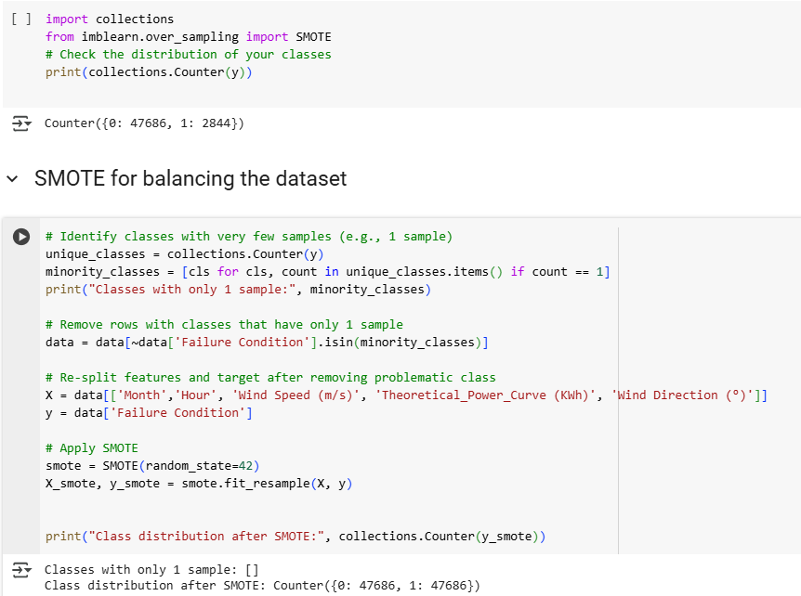
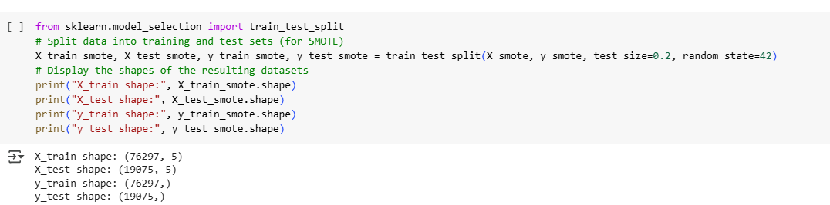
Feature Extraction
Imbalance Handling: Applied SMOTE (Synthetic Minority Oversampling Technique) to balance the dataset for accurate classification.
Splitting Data: The dataset is split into training and testing sets.
These steps ensure a clean, balanced, and well-structured dataset, leading to improved model performance in failure detection and power prediction.

Slide 12
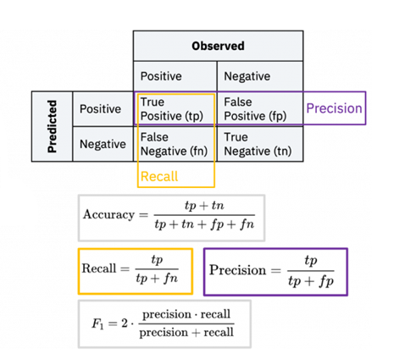
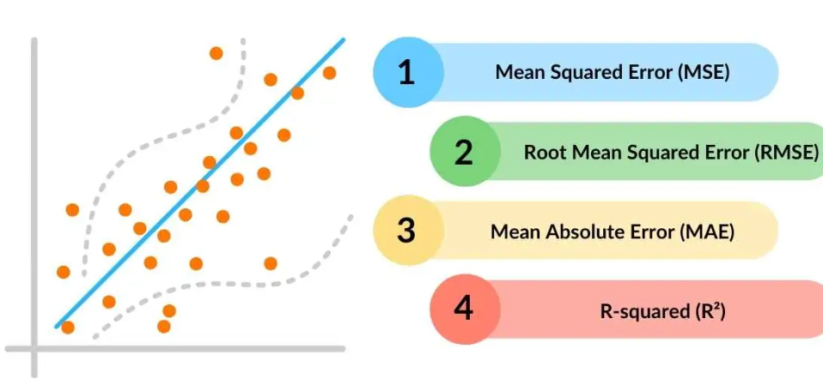
Evaluation Metrics
Regression Models
Classification Models

Slide 13
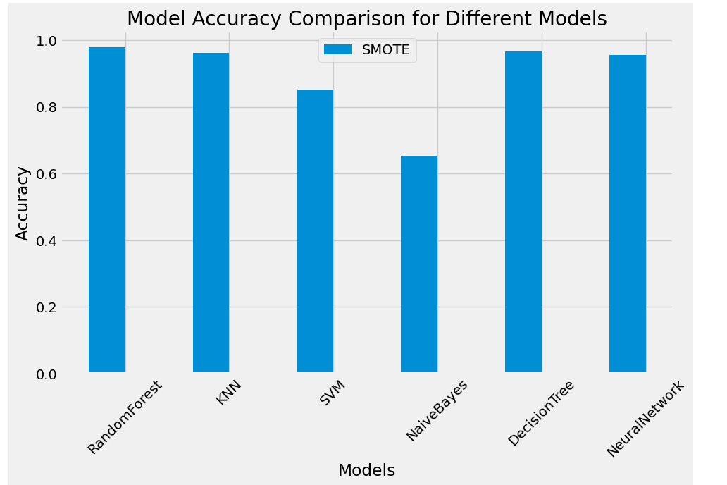
Classification Model Results
The classification models were evaluated based on accuracy, precision, recall, F1-score to detect turbine failures.
Random Forest achieved the highest accuracy (97.86%), making it the most reliable for failure detection.
Decision Tree and Neural Network performed well (~96%), balancing precision and recall effectively.
KNN had 96.2% accuracy, but it was computationally expensive for large datasets.
SVM (85.3%) and Naïve Bayes (65.3%) struggled, with lower recall, leading to missed failure detections.
Confusion matrices showed that Random Forest had the lowest false negatives, ensuring that most failures were detected accurately.
Conclusion: Random Forest is the best classification model, providing the highest reliability in predicting wind turbine failures.

Slide 14
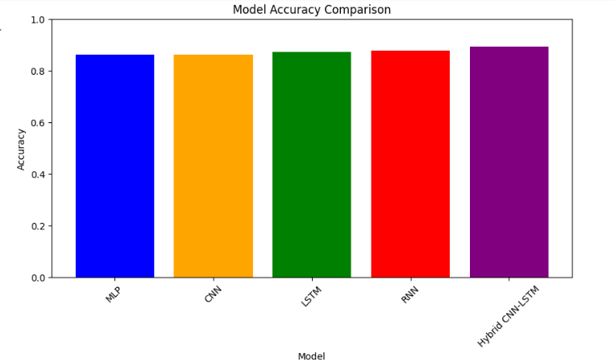
Deep Learning Classification Results
The performance of various deep learning models in wind turbine fault detection is evaluated based on accuracy metrics:
Hybrid CNN-LSTM: Achieves the highest accuracy of 0.8941, demonstrating strong feature extraction and temporal pattern learning.
LSTM (Long Short-Term Memory): Performs well with an accuracy of 0.8736, effectively capturing sequential dependencies in SCADA data.
RNN (Recurrent Neural Network): Achieves an accuracy of 0.8771, showing improved sequence modeling capabilities.
CNN (Convolutional Neural Network): Records an accuracy of 0.8634, excelling in spatial feature extraction.
MLP (Multilayer Perceptron): Scores 0.8623, showing competitive performance despite its simpler architecture.
Conclusion: Among all models, the Hybrid CNN-LSTM exhibits the best accuracy, highlighting the advantage of combining spatial and temporal feature learning.

Slide 15
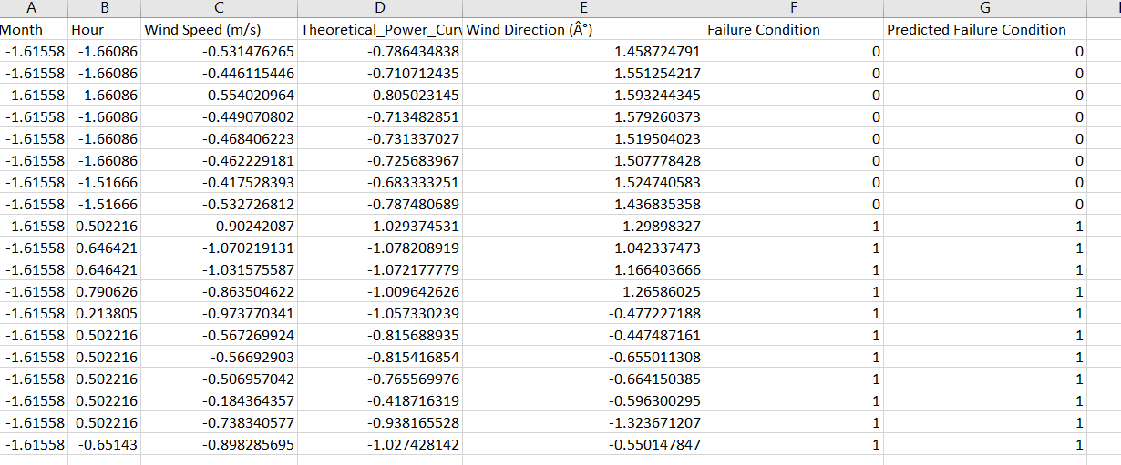
Classification Prediction Results
Failure Condition vs. Predicted Condition: Model accuracy is assessed by comparing actual turbine failures with predicted failures.
Key Takeaways:
High prediction accuracy enables early fault detection and reduces false alarms.
Supports proactive maintenance strategies, preventing unexpected failures.
Reducing downtime and repair costs, improving turbine efficiency and lifespan.
Real-time fault monitoring enhances operational reliability and grid stability.
Advanced deep learning models significantly improve wind turbine health monitoring, leading to smarter energy management and cost-effective maintenance strategies.

Slide 16
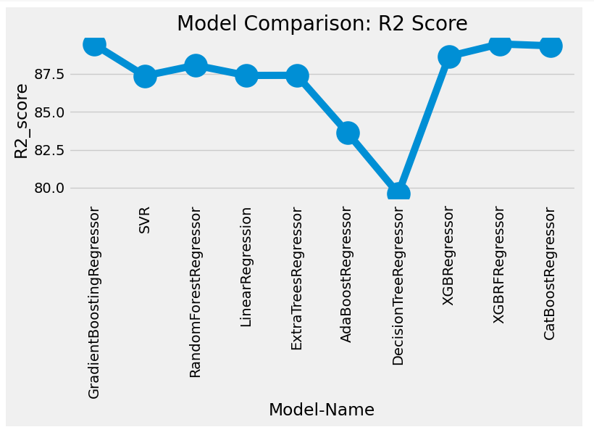
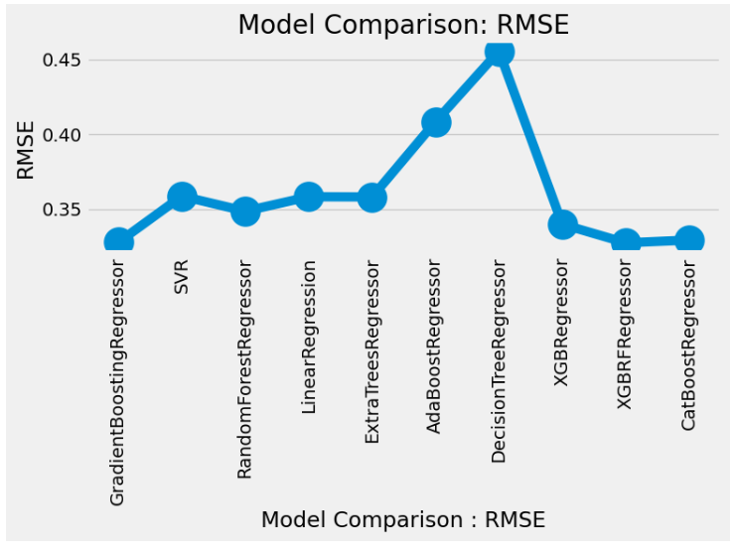
Regression Model Results
The regression models were assessed using R², MSE, RMSE, and MAE to predict turbine power output.
XGBoost (R² = 89.47%) and CatBoost (R² = 89.35%) were the most accurate models, effectively capturing complex relationships in wind power generation.
Gradient Boosting (89.44%) and Random Forest Regressor (88.06%) performed well, but slightly below boosting models.
Linear Regression (87.39%) and SVR (87.36%) had lower predictive power, struggling with non-linearity in wind data.
RMSE values confirmed that XGBoost and CatBoost had the lowest prediction errors, making them the best models for forecasting power output.
XGBoost and CatBoost are the most accurate regression models, making them ideal for predicting wind turbine energy generation.

Slide 17
Conclusion & Future Work
Conclusion
Machine learning models effectively detect turbine failures and predict power generation.
Random Forest (97.86% accuracy) was the best classification model for failure detection.
XGBoost and CatBoost (R² ~89%) provided the most accurate power output predictions.
SMOTE balancing improved failure classification accuracy.
AI-driven predictive maintenance can reduce turbine downtime and optimize energy efficiency.
Future Work
Incorporate real-time weather data for improved predictions.
Explore deep learning models (LSTMs, CNNs) for enhanced failure detection.
Develop a real-time monitoring system integrating IoT-based wind sensors.
Expand dataset coverage to include multiple turbine sites for better generalization.
Optimize energy forecasting models using hybrid AI approaches.

Slide 18
References
Erisen, B. Wind Turbine Scada Dataset: 2018 Scada Data of a Wind Turbine in Turkey.
Zhang, G., Li, Y., Jiang, W., & Shu, L. (2022). A fault diagnosis method for wind turbines with limited labeled data based on balanced joint adaptive network. Neurocomputing, 481, 133-153.
Yang, W., Tavner, P. J., Crabtree, C. J., Feng, Y., & Qiu, Y. (2014). Wind turbine condition monitoring Technical and commercial challenges. Wind Energy, 17(5), 673– 693. doi: 10.1002/we.1508
Kusiak, A., & Li, W. (2011). The prediction and diagnosis of wind turbine faults. Renewable Energy, 36(1), 16–23. doi: 10.1016/j.renene.2010.05.014
Kusiak, A., & Verma, A. (2011). A data-driven approach for monitoring blade pitch faults in wind turbines. IEEE Transactions on Sustainable Energy, 2(1), 87–96. doi: 10.1109/TSTE.2010.2066585.
Sasinthiran, A., Gnanasekaran, S., & Ragala, R. (2024). A review of artificial intelligence applications in wind turbine health monitoring. International Journal of Sustainable Energy, 43(1), 2326296.
Zitrou, A., Bedford, T., & Walls, L. (2016). Predictive maintenance strategies for wind turbines: A risk-based approach. Reliability Engineering & System Safety, 149, 174-185.
Ibrahim, R., Weinert, M., & Watson, P. (2016). Application of support vector machines in wind turbine fault detection. Energy Informatics, 20(3), 112-134.
Abdallah, I., Ntertimanis, V., & Mylonas, C. (2018). Decision tree learning for wind turbine fault diagnosis. Safety and Reliability Journal, 3053(2), 125-142.
Orozco, R., Sheng, S., & Phillips, P. (2018). Machine learning in wind turbine health monitoring: A comparative study. Renewable Energy, 33(4), 226-240.
Jiang, L., Hu, X., & Li, Y. (2020). Semi-supervised learning for wind turbine failure localization. Machine Learning in Energy Systems, 41(6), 315-329.
Zhu, A., Zhao, Q., Yang, T., & Zhou, L. (2023). Deep learning-based condition monitoring for wind turbines. Computer and Electrical Engineering, 105, 108538.
Liang, L., Liu, F., Li, M., He, K., & Xu, G. (2016). Feature selection for machine fault diagnosis using clustering of non-negation matrix factorization. Measurement, 94, 295-305.

Slide 19
THANK YOU

